Slide 1
R Vignettes II
Matthew Kumar
January 13, 2020

Slide 2
Organization
An extension of the R Vignettes rounds presentation from 2017
Content includes a little bit of everything, illustrated with code snippets or screen shots where possible
Focus is on things we usually need to do and how to do some of them in R

Slide 3
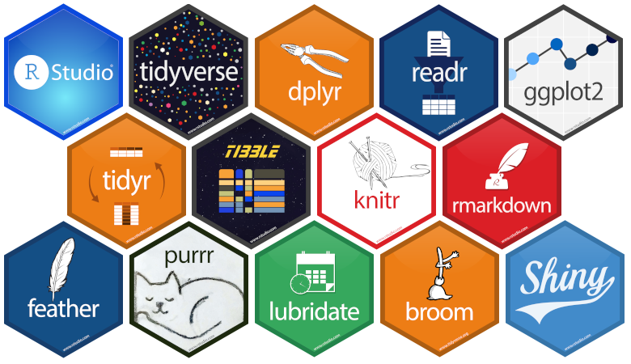

What do we do?
Data analysis, Data management
The {Tidyverse} is a collection of R packages geared towards everyday data analysis.
www.tidyverse.com
Notes:
Tidyverse – all packages have a similar design philosophy and play well together.
In contrast to base R,
-a lot more user friendly,
-intuitive
-allows you to transition from different parts of the project (programming, analysis, visualization, presentation) very easily

Slide 4
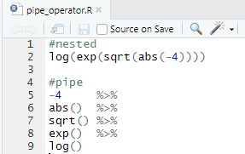

The Pipe Operator
R programming involves heavy use of functions
The pipe operator can help breakdown complex code into ordered and readable steps.
The output of one function is passed as input to the next function through the %>%
Ubiquitous in the {Tidyverse} and online examples/tutorials.
Notes:
-Don’t need to save intermediate objects
-Easier to debug
-The 2nd example filters a cut of ohip to male, sorts by ikn, servdate, keeps first servdate for each person

Slide 5
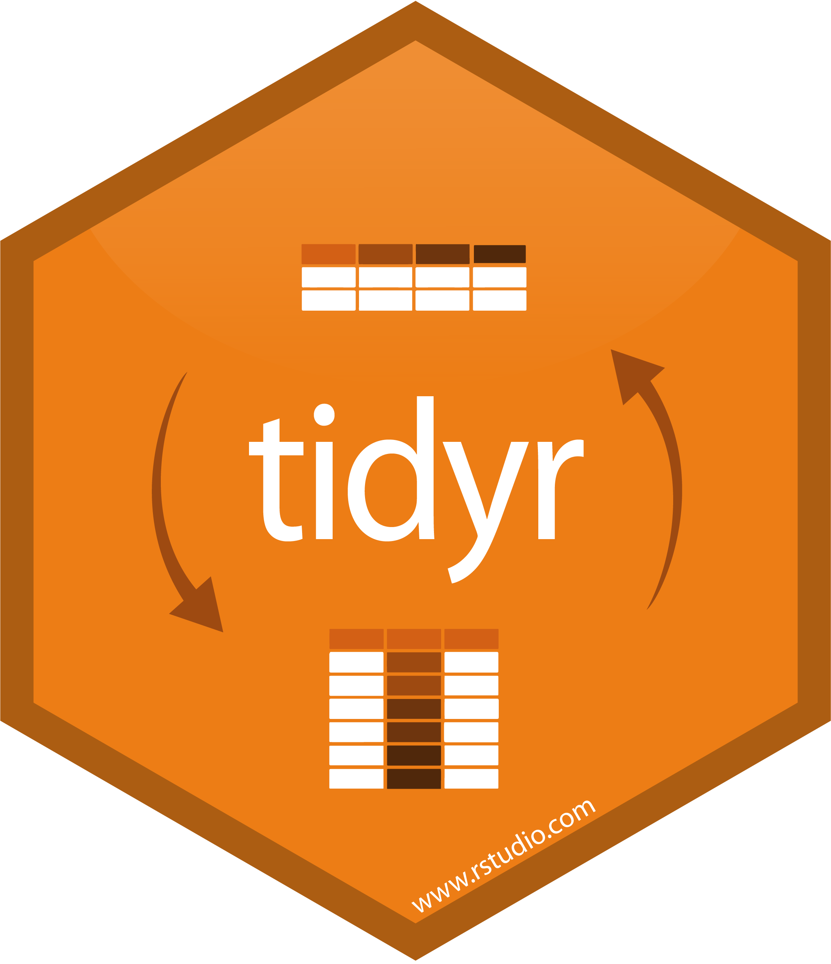
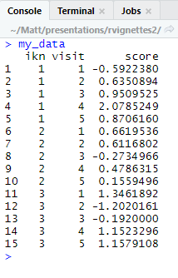
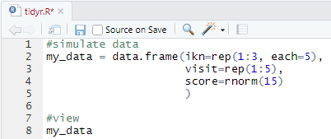
Transposition
Some functions expect data structured in a certain way (e.g. long or wide), like SAS procs.
It’s handy to know the basics of how to convert from one another in R.
Example Data
Notes:
Especially if you’re coming into R with very specific purpose.
If you find along the way another, new function that better suits your needs, you don’t want to go back to SAS, transpose, reexport, reimport, then use the new function.

Slide 6
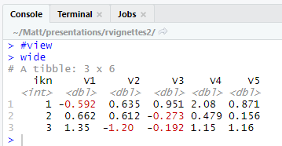
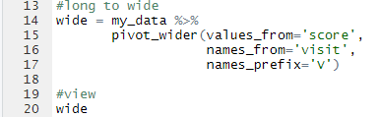
Transposition
Transposing Long to Wide is accomplished with pivot_wider()
Notes:
Read documentation on how to do more complex.
Example assumes IKN is the only grouping variable, because it’s the only one not specified.
If another variable was in there, say rurality, it would have been transposed by both (ikn, rural for example)

Slide 7
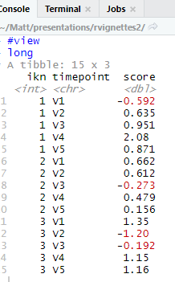
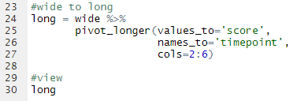
Transposition
Transposing Wide to Long is accomplished with pivot_longer()
Notes:
Read documentation on how to do more complex operations.
Here columns to transpose is specified by column numbers – there are other approaches like a wild card for prefix (all variables that start with “V”)

Slide 8
Tips on Modeling in R
Post-processing of modeling results
Considerations for stratified modeling
Saving modeling objects

Slide 9
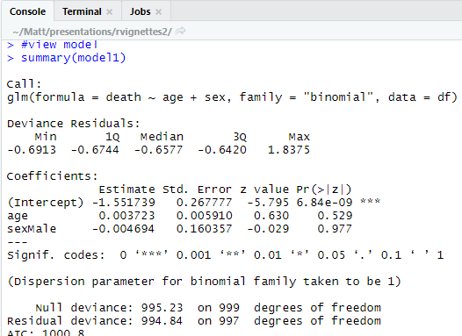
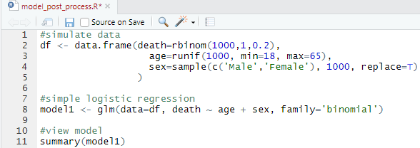
Post-processing of modeling results
Scenario: Fit a model, want to get the output in a usable format

Slide 10
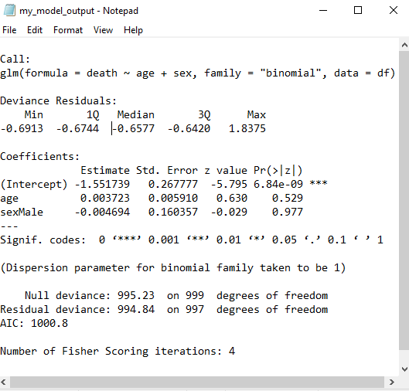

Post-processing of modeling results
Not immediately useful, needs a bit of work.
sink()
Notes:
Sink() will redirect whatever appears in the console to a file
Kind of like ods, kind of not
No formatting

Slide 11
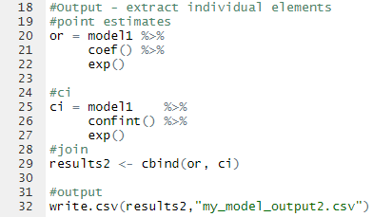
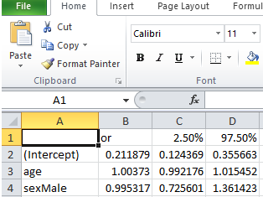
Post-processing of modeling results
Laborious, potentially error prone
extract and assemble
Notes:
Work with the model object directly
Pluck out elements individually
Manipulate and export

Slide 12

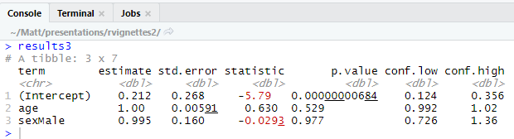
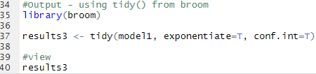
Post-processing of modeling results
Concise, effortless, usable
Supports several modeling frameworks (gee, lme, coxph, ts, coxme, etc)
??tidy at the console will show full list of supported models and functions (e.g. t.test() )
tidy()
Notes:
-Provides results in a usable format (data frame) with most quantities computed (consult documentation)
-Mention the CI is a profile likelihood CI and not Wald – look to documentation

Slide 13
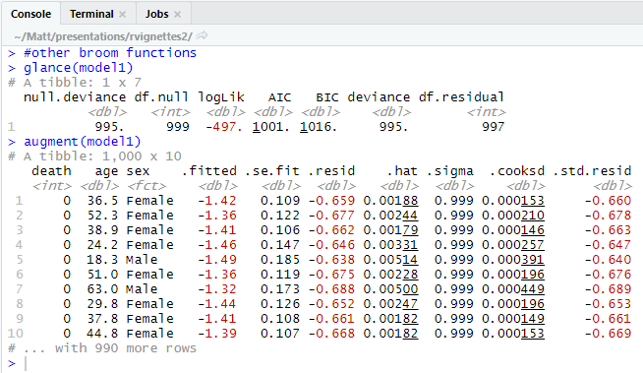
Post-processing of modeling results
glance() and augment()
Notes:
-glance returns model summary / fit information
-augment appends residuals, predicted values, etc to data frame

Slide 14
Considerations for stratified modeling
Scenario: Want to fit a series of models by a stratifying variable (e.g. death ~ age, for each sex separately)
There’s no direct `by statement` analog in R
Try 1: Can subset data for each strata, fit model, output individually
Try 2: Make use of the %>% operator…

Slide 15
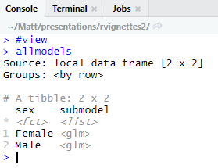

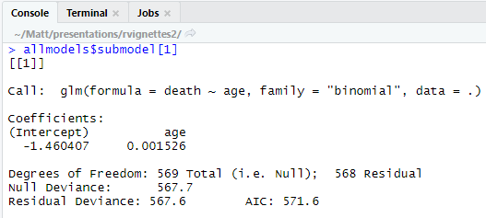
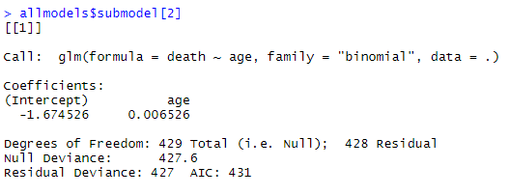
Considerations for stratified modeling
Notes:
Use the Pipe operator and dplyr verbs (group_by) to fit a series of stratified models
What’s returned is a nested data frame
For each strata, there is a model under “submodel” for it in a list
You can access the elements individually

Slide 16
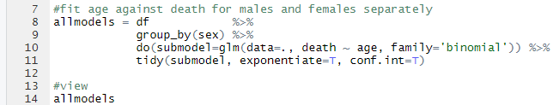
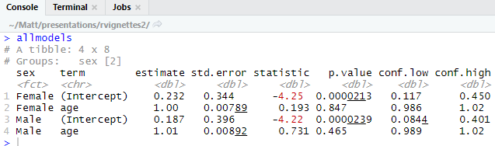
Considerations for stratified modeling
One step further…
Notes:
Extend what you’ve learned so far – use the pipe and tidy() to make a nice output ready for exporting

Slide 17
Saving Model Objects
Scenario: Fit a model, took 24 hours to run, only saved coefficients, closed session.
Two days later you realize you need to do additional tasks with the model.
Re-run, wait another 24 hours, complete additional tasks?
Save the model as an “object” that can be imported later, after closing the session.

Slide 18
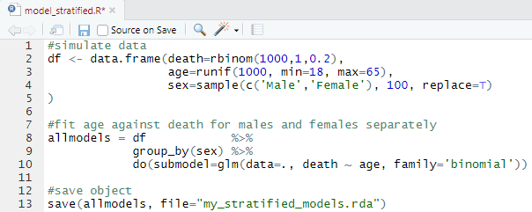
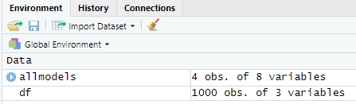
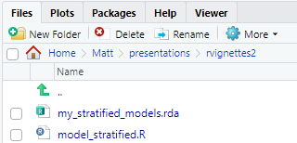
Saving Model Objects
save()

Slide 19
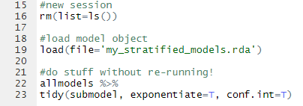
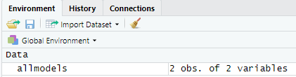
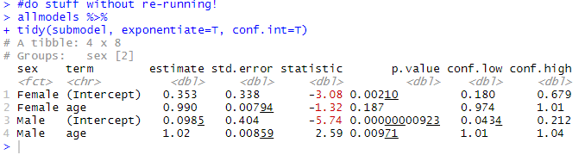
Saving Model Objects
load()
By default, data is usually saved in the model object - look at package documentation.
Notes:
Look at the package documentation for the model you are running.
We didn’t save the dataset, df, so it’s not loaded back into the environment
The model object has a copy of the data – might want to look at documentation to see if its retained automatically – can grow in size quite a bit otherwise
Works with any object, not just modeling
In SAS, you might have to re-run the analysis if you close the session.
Proc PLM might have some provision for keeping models objects – haven’t looked into it enough…

Slide 20
Editable Power Point Graphics
Some journals prefer (or require) submission of manuscript figures as ‘editable Microsoft Office files’.
In general, its sometimes easier to manipulate elements of a graph directly rather than program exact specifications.
Even so, this is typically done using commercial or open source graphic software (e.g. Adobe) which might not be available.
The {officer} package can help here.

Slide 21

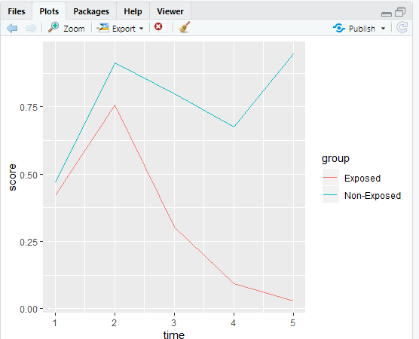
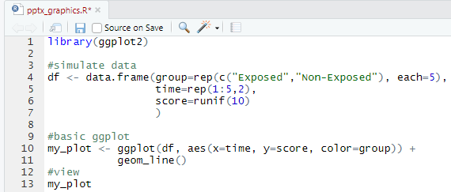
Editable Power Point Graphics
1) Create an R graphic
Notes:
Have tested ggplot2 and base R graphics so far.

Slide 22

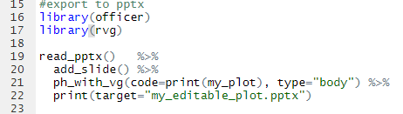
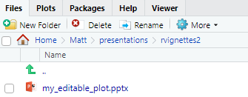
Editable Power Point Graphics
2) Export to .pptx

Slide 23
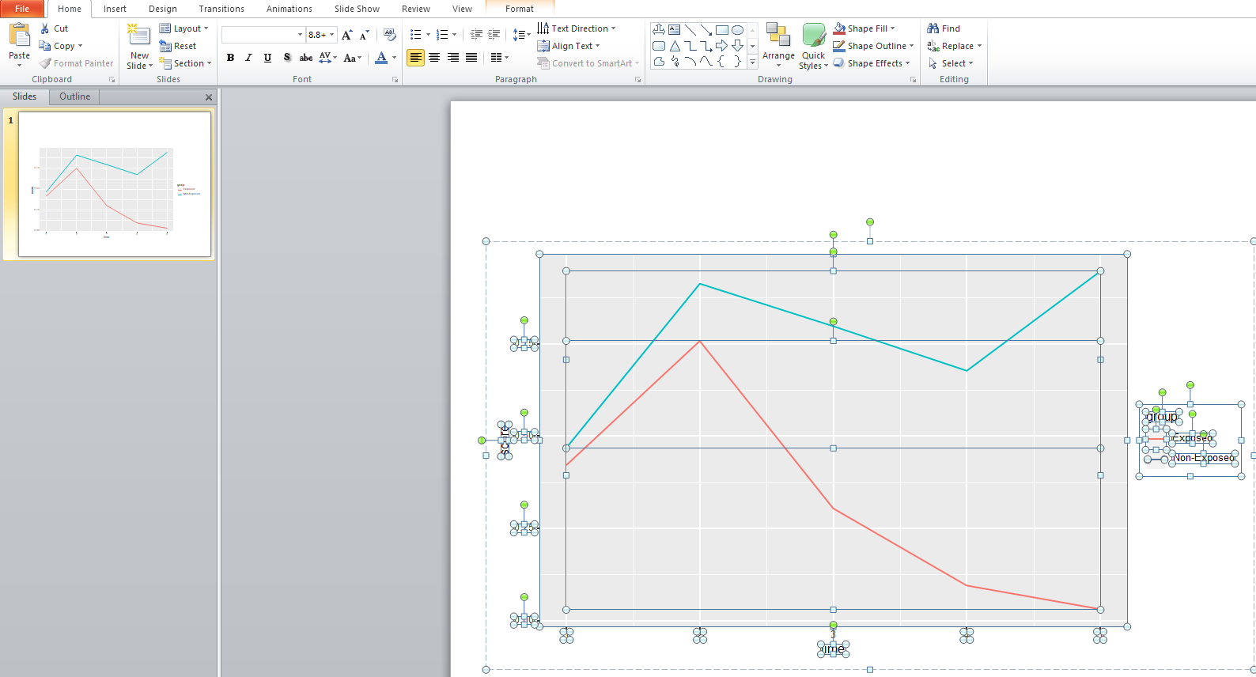

Editable Power Point Graphics
3) Edit
Notes:
All elements of the graph are editable in power point – text and shapes

Slide 24
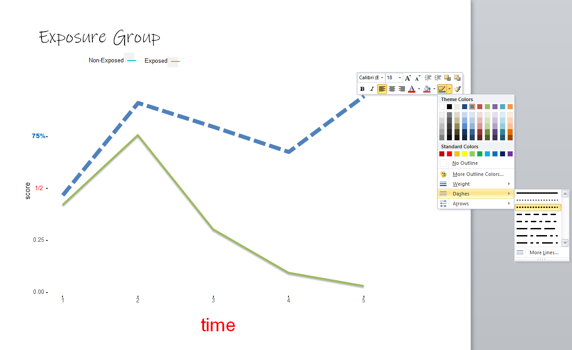
Editable Power Point Graphics
3) Edit, but judiciously…
Notes:
You lose reproducibility the more you edit, which means more manual work should the data change.
This slide is just to show really how easy things COULD be edited in a familiar environment (everyone generally familar with Office products)

Slide 25
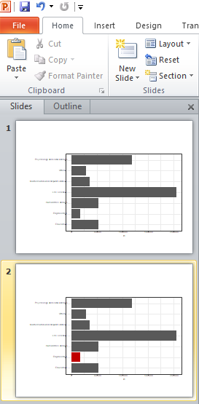
Editable Power Point Graphics
3) Edit
Notes:
A more realistic example
-want to change 1 or two things
-can be done programmatically, but sometimes tedious to program a very exact specification.

Slide 26

Accessible Graphics
The {viridis} package provides colorblind friendly palettes for R graphics.
These palettes also display well when printed in grey scale.
A Great article on how they were created and how they appear under different types of simulated colorblindness (deuteranopia, protanopia, tritanopia)
Notes:
Easy to apply out of the box
Perceptually uniform

Slide 27
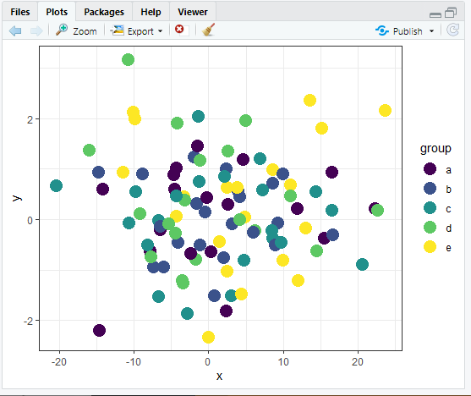
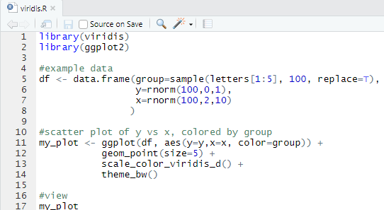
{viridis} implementation
Notes:
Quick example – can be skipped if running behind…

Slide 28
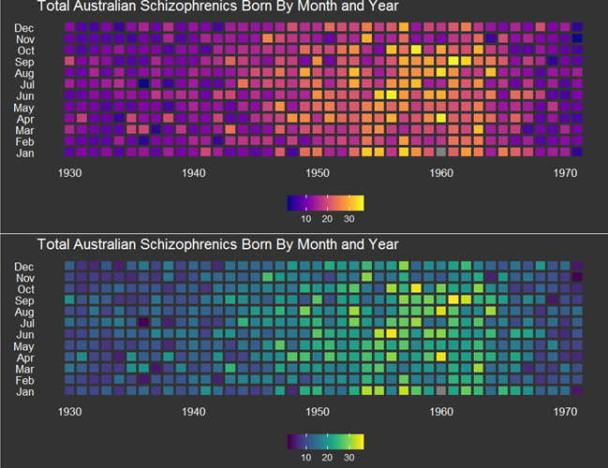
{viridis} examples
Notes:
Quick example – can be skipped if running behind…

Slide 29
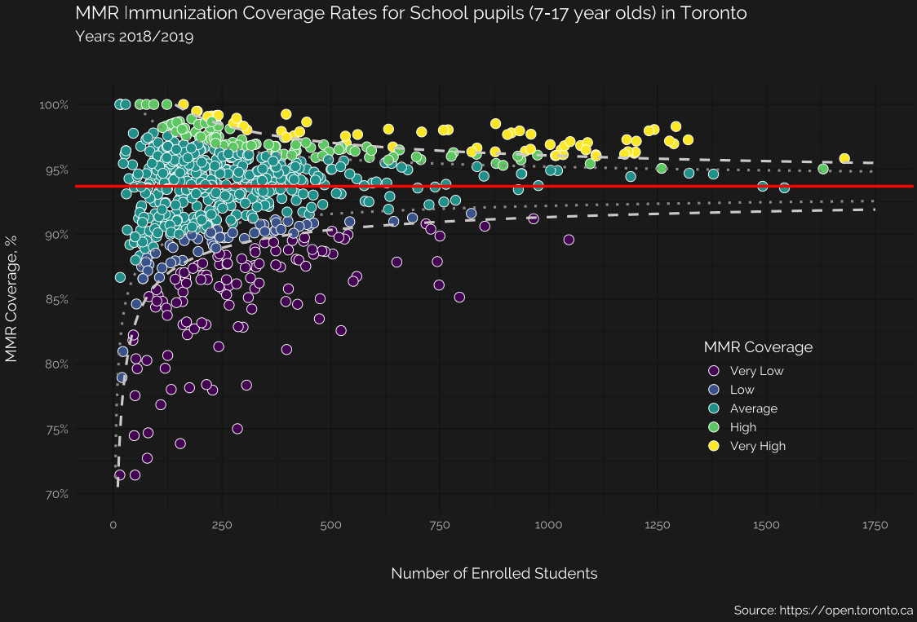
{viridis} examples
Notes:
Quick example – can be skipped if running behind…

Slide 30
External Data and R
Application Programming Interface
Access and retrieve resources (i.e. data) from an external platform in a programmatic way.
Some APIs are open, while others require a token in order to access data (can be free or paid).
APIs in R are made available through packages.
Need to read documentation for Terms of Use.

Slide 31
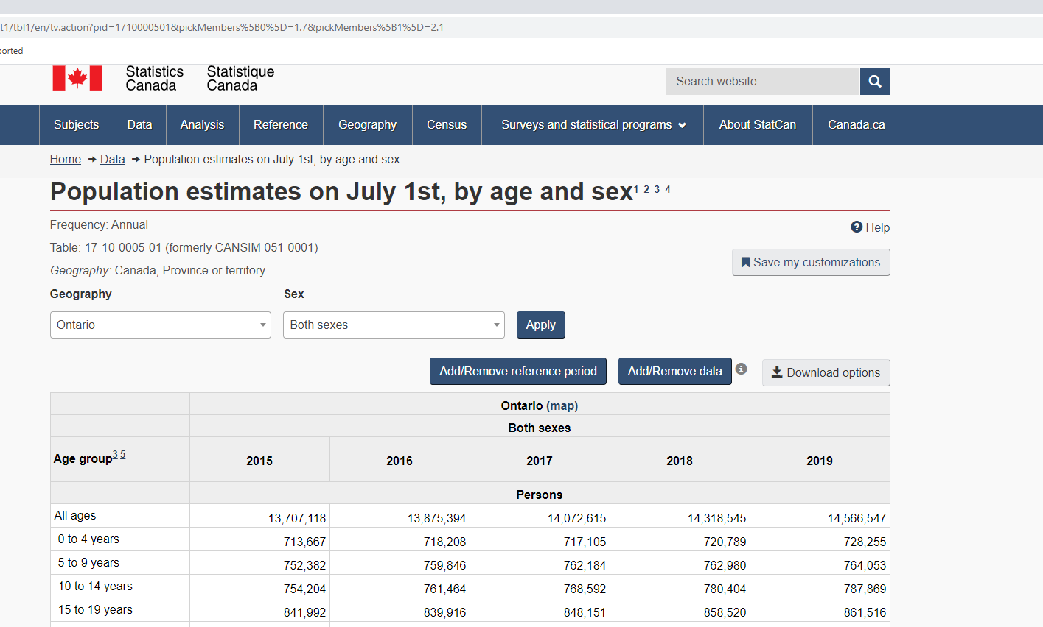
Statistics Canada API
You can access Statistics Canada data directly in R through the {cansim} package.
This API requires you specify a table number to retrieve data
Example:

Slide 32
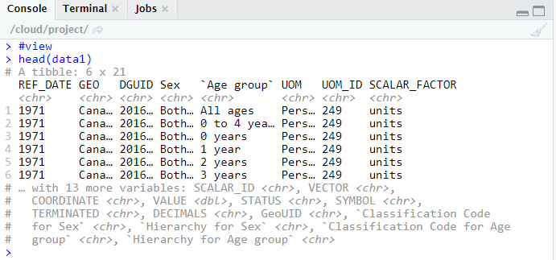
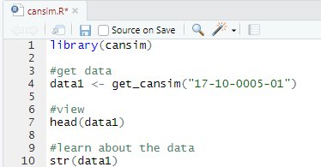
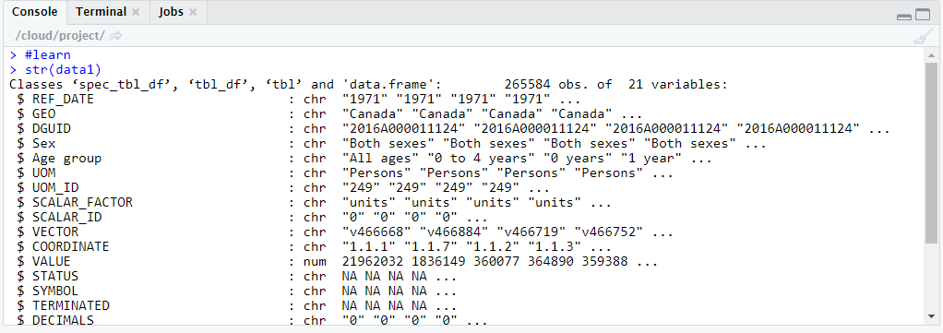
Statistics Canada API

Slide 33
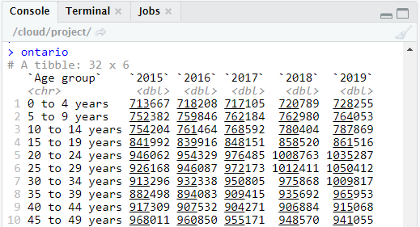
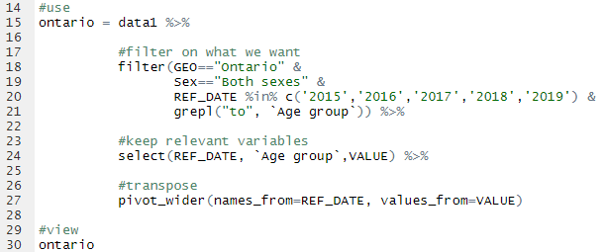
Statistics Canada API

Slide 34
Other APIs in R
{rtweet} – Access Twitter data (hashtags, tweets, retweets, trends, etc.)
{easyPubMed}, {rplos} – Search and retrieve meta data, references, etc from PubMed and PLOS
{opendatatoronto} – Interface to City of Toronto Open Data Portal – good for datasets for learning R
{leaflet} – Open Source Mapping Library
{plumber} – Serve your own analysis as an API for others to access as a web service – predictive modeling

Slide 35

Productivity
{rmarkdown} is a general purpose authoring framework in R
Uses a combination of markup language + R code to generate a variety of documents
Some real world uses:
Single analysis – sharing study results with team
Report generation – Atlas style publications, provider / subscriber reports
Presentations, slide decks
Guides – Methodological tutorials
Books, manuscripts, thesis
CV or resumes
Websites and blogs
Appeal is in streamlining analysis and authoring with the benefit of being reproducible

Slide 36
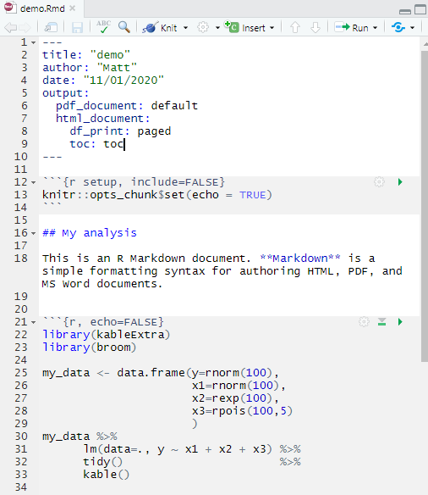
Productivity
markup
R code

Slide 37
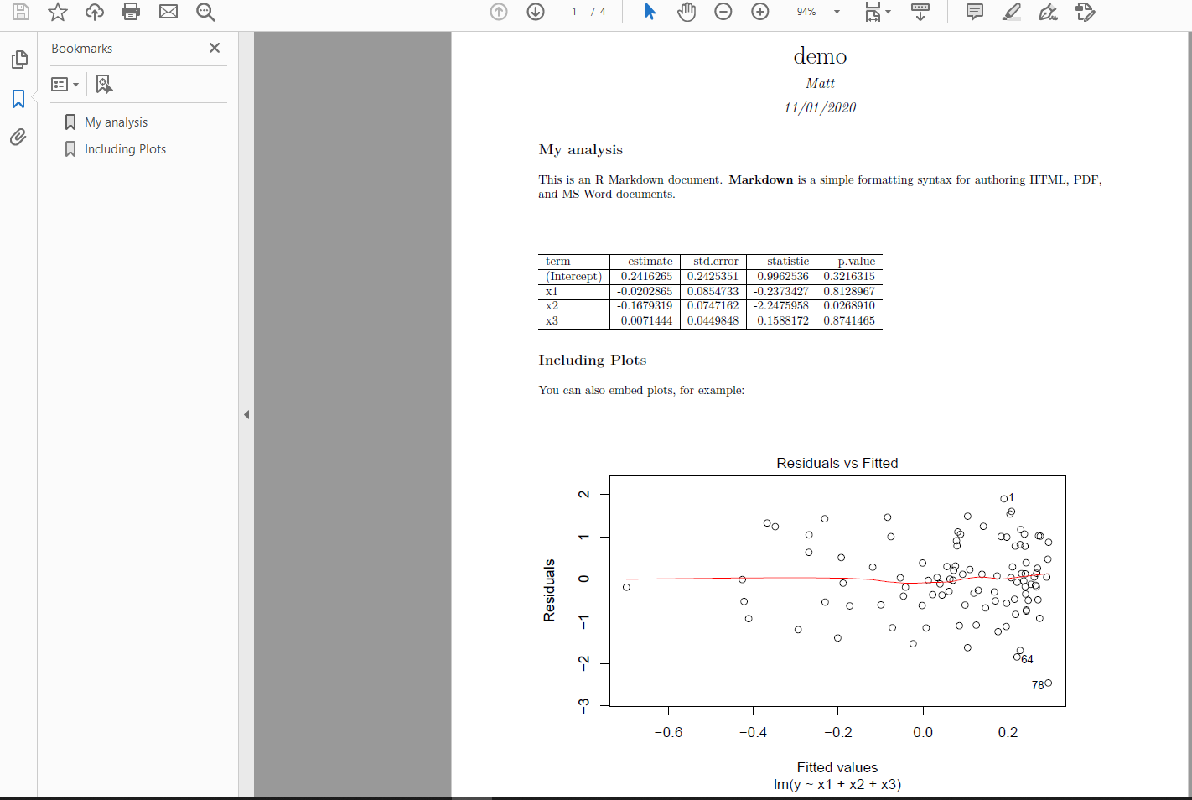
Productivity

Slide 38
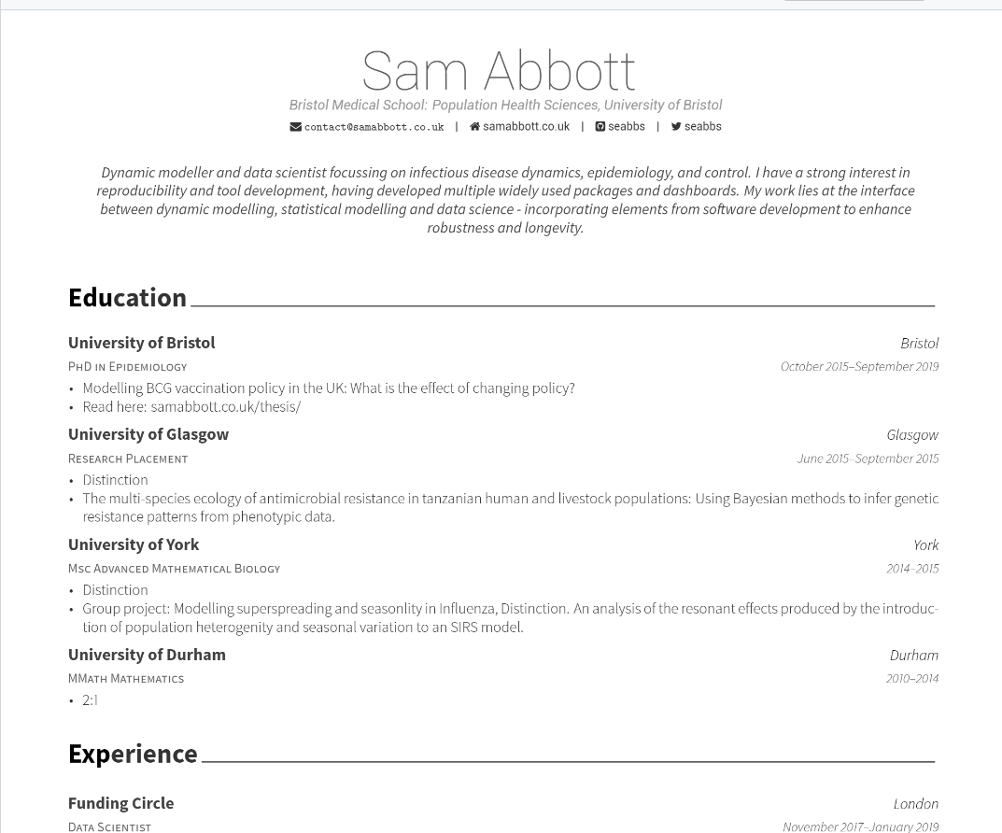
Productivity

Slide 39
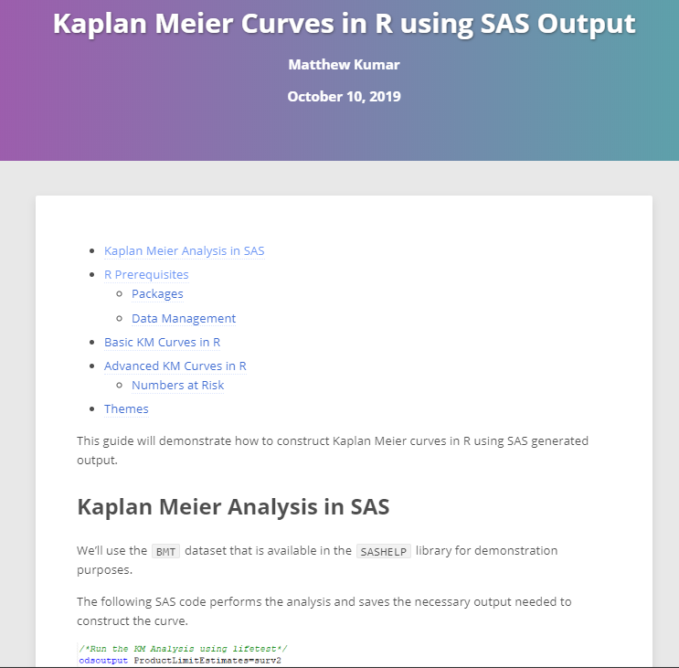
Productivity
{rmarkdown} can also be easily published to html, not just pdf/doc
http://rpubs.com/matt-kumar/km-sas-r
Notes:
http://rpubs.com/matt-kumar/km-sas-r

Slide 40

Creating Interactive Macros
{shiny} is a web-application framework in R and is part of the tidyverse
Like {rmarkdown}, it blends traditional R code with a lightweight syntax for creating applications.
Can create self-contained analysis (e.g. dashboards), or tools that create things.
In either case, the end-user doesn’t need any R knowledge to use them.
Can be hosted online through the internet OR ran completely locally from R.
Shiny app design philosophy - “ a visual SAS macro”.

Slide 41
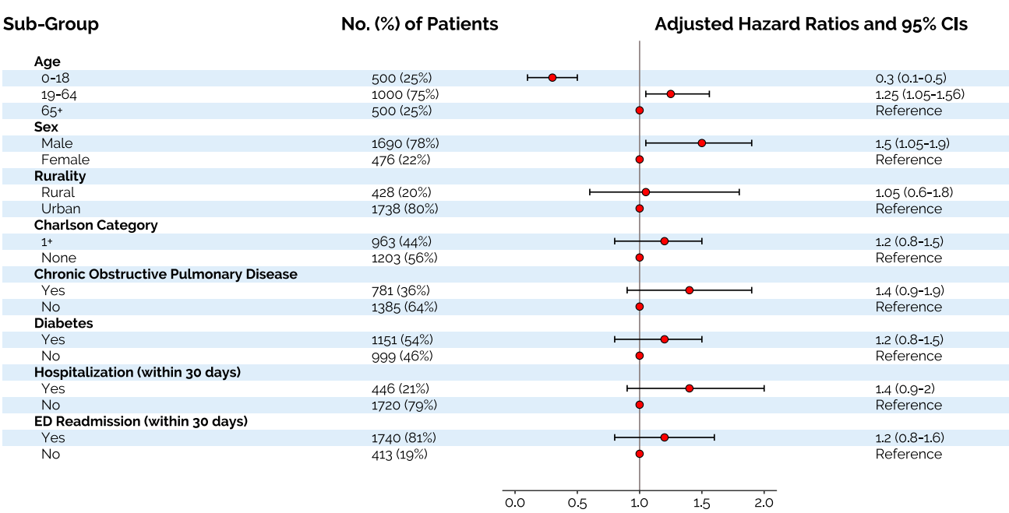
Creating Interactive Macros
A visual macro to create forest plots
Notes:
We’ve all had to make them and they can be a pain
If you can agree on a template/format, it’s a good candidate for a shiny app – write the code once, potentially tedious, turn it into something reusable for everyone
Shiny helps with user experience and changing some parameters with ease – user friendly

Slide 42
Creating Interactive Macros
Forest Plot
Application: https://matt-kumar.shinyapps.io/forestR
Standalone Code: https://github.com/mattkumar/forestplot
Notes:
Of course this macro doesn’t do everything to your own specification – stand alone code is available for you to extend/customize

Slide 43

Next Steps
Code and Output for this presentation available here: https://github.com/mattkumar/icestalk

Slide 44




Next Steps
Rstudio.cloud – R Studio from the cloud, free to sign up and use, great sandbox for learning R and trying out new packages.
R4DS – R for Data Science by Wickham and Grolemund – Free online
Cheat Sheets – Quick references to many popular R packages, not just Tidyverse

Slide 45
Thank You

